Slide 1

Google Play Apps Analysis- Executive Presentation
Date: 01-15-2021
Presenter: Xiangning Bu

Slide 2
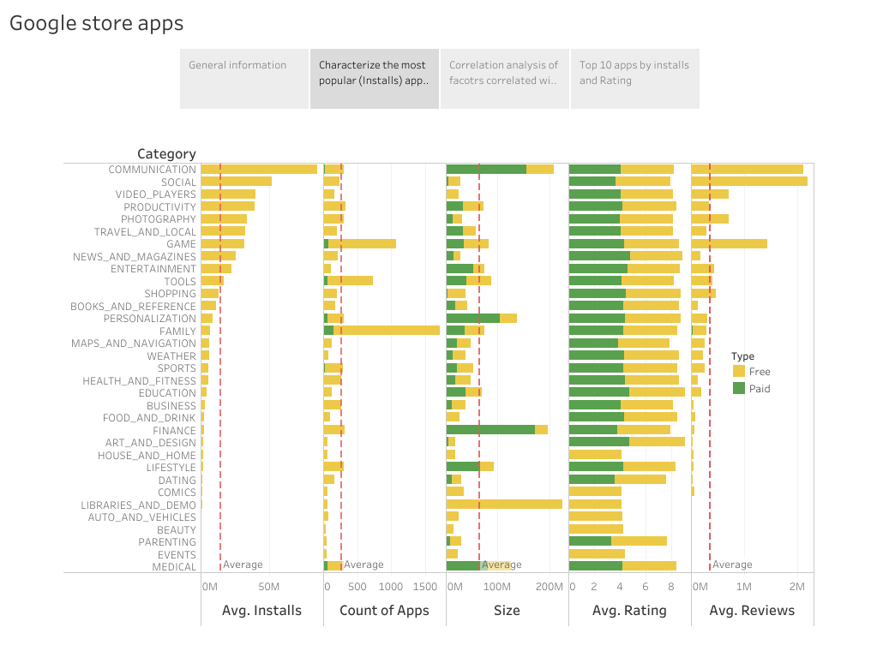
Marketing observation suggests free apps, with a medium size, especially in communication and social categories have much more installs, which results in more reviews and high ratings
Key insights:
Although family and game apps compose more one third of the google app market, the communication and social apps have higher average installs.
Most of the apps have a medium size of 0-50M, while the free apps have smaller or equal size to paid apps.
More installs lead to higher average reviews counts. The average rating for both free and paid apps are around 4.
For the paid apps, increase of price results in lower installs.
Source: Kaggle Google Play Store Apps datasheet

Slide 3
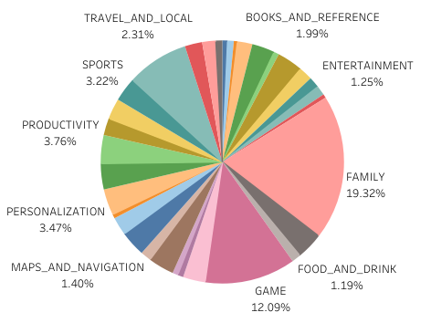
Although family and game apps compose more one third of the google app market, the communication and social apps have higher average installs.
Total Apps: 8,190
Total Installation: 146B
Insights:
Among the 8190 apps, there are more than1000 apps in both family and game categories, while only around 250 apps in communication and social categories .
The average installs are much higher in communication and social categories (>50M) than that of family and game categories, which might be due to the intensive competitive marketing of these apps.

Slide 4
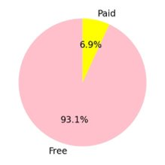
Most of the apps have a medium size of 0-50M, while the free apps have smaller size or equal size to paid apps
Insights:
There only 6.9% of apps are not free. Paid apps tend to be bigger than free apps in communication, personalization, finance lifestyle and medical categories.

Slide 5
More installs leads to higher average reviews counts. The average rating for both free and paid apps are around 4

Slide 6
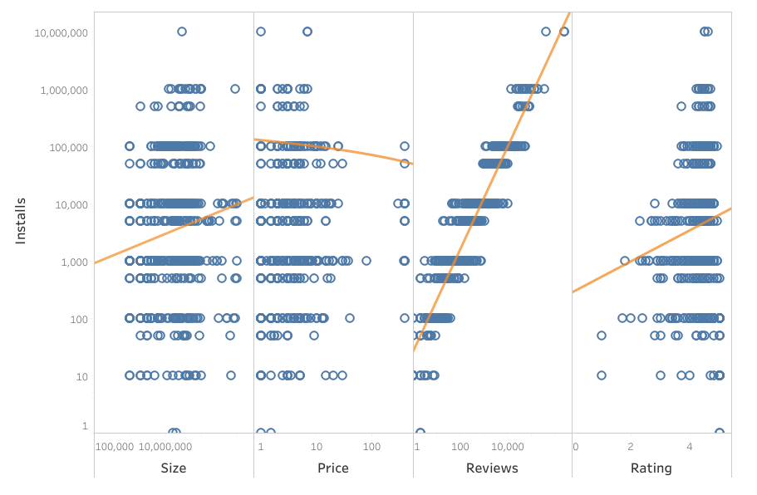
For the paid apps, increase of price results in lower installs

